Slide 1
Challenging the myths: what does it mean to live well with HIV?
Dr Laura Waters MD FRCP
Consultant Physician Sexual Health & HIV
British HIV Association Chair
@drlaurajwaters lwaters@nhs.net

Slide 2
Who am I?
HIV & sexual health doctor
Doctor since 1998, worked in HIV & sexual health since 2002
Consultant since 2012
HIV lead for CNWL since 2018
Co-chair London HIV Clinical Forum
Chair British HIV Association (BHIVA) until January 2023
National Specialty Advisor for HIV to NHS England & HIV Clinical Reference Group (CRG) chair

Slide 3
Content
1
2
THEN
NOW
3
4
FUTURE
CLOSING
THOUGHTS

Slide 4
1
THEN

Slide 5
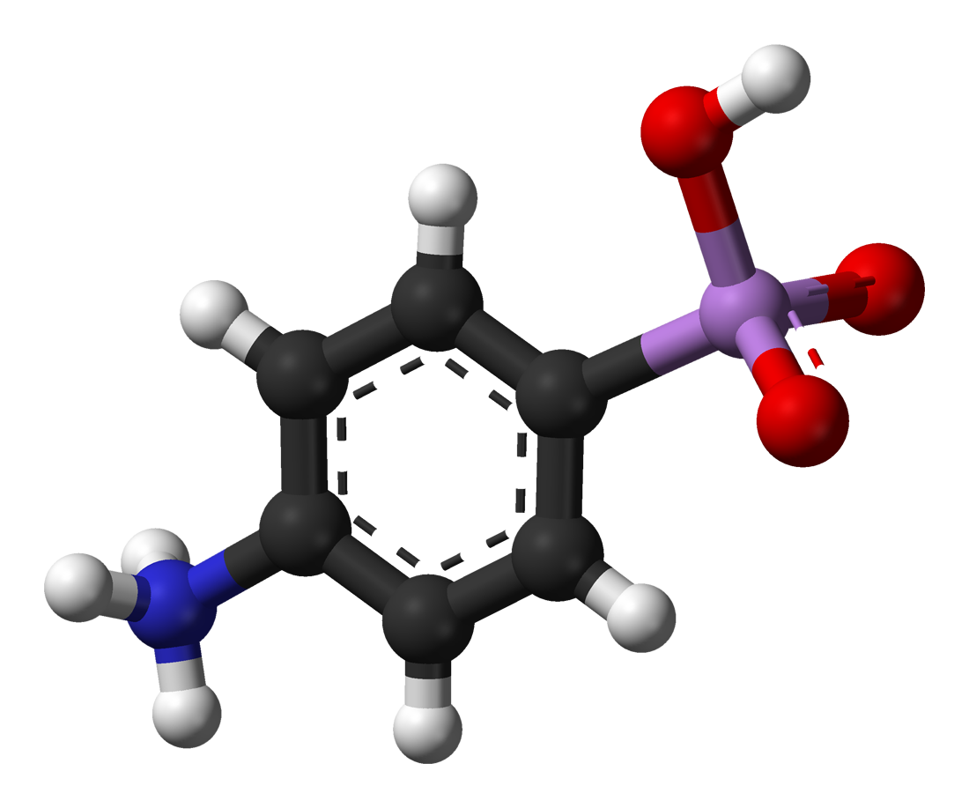
1920
1950
1959
#SEXWORKISWORK
Notes:
A phylogeographic study published in 2014 concluded that HIV originated in Kinshasa around 1920. DRC is the size of Western Europe
Numerous cases pre-late 1950s of deaths due to, what with hindsight, was AIDS but the first proven case was a 1959 case identified retrospectively in the late 1990s.
Data from colonial archives tells us that by the end of 1940s over one million people were travelling through Kinshasa on the railways each year; Our genetic data tells us that HIV very quickly spread across the Democratic Republic of the Congo (a country the size of Western Europe), travelling with people along railways and waterways to reach Mbuji-Mayi and Lubumbashi in the extreme South and Kisangani in the far North by the end of the 1930s and early 1950s https://economictimes.indiatimes.com/magazines/panache/origin-of-aids-found-study-reveals-hiv-pandemic-started-in-kinshasa-in-1920s/articleshow/44199722.cms
In 18 months starting in 1917, French physician Eugene Jamot treated 5347 cases of African trypanosomiasis (sleeping sickness) with injections of atoxyl, a toxic arsenical, using 6 syringes, some patients developed hepatitis……
Numerous papers have been written on the ‘injection theory’ of HIV genesis but it is often overlooked – the widespread use of transfusions, injectable treatments & re-use of injecting equipment may have contributed more than has been appreciated; tendency to assume heterosexual transmission, and an emphasis on concurrency, may have led to downplaying of iatrogenic transmission and under-reporting of MSM who identify as heterosexual
https://www.ncbi.nlm.nih.gov/pmc/articles/PMC4254776/

Slide 6
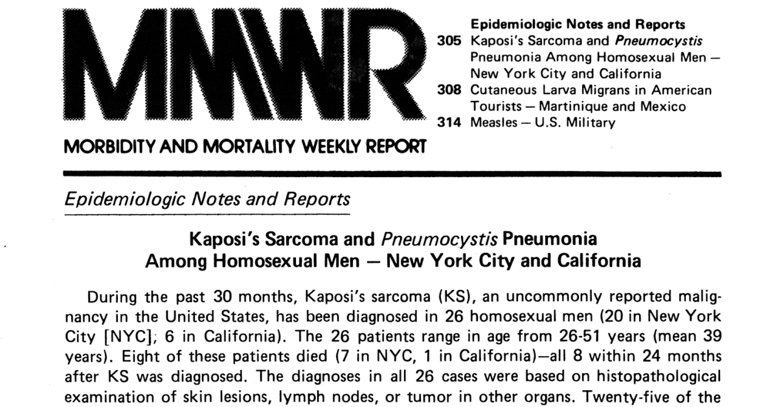
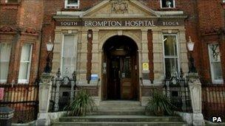
JUNE
1983
1981
CDC at risk of AIDS
“4-H Club”
Homosexuals
Haemophiliacs
heroin addicts
Haitians.
DECEMBER
Notes:
1981: June 1st cases of PCP, then KS, then other OIs in gay men in US – first clinical reports of AIDS
July 1981: press referring to ‘Gay men’s pneumonia followed by ‘gay cancer’
August 1981: of 108 KS/PCP cases, 107 male, most gay/bisexual and 40% had died
December 1981: 5 black infants with OI incl PCP, at least 3 born to mum’s who use drugs or engage in sex work
By end of 1981 337 reported cases in US, 130 already dead

Slide 7
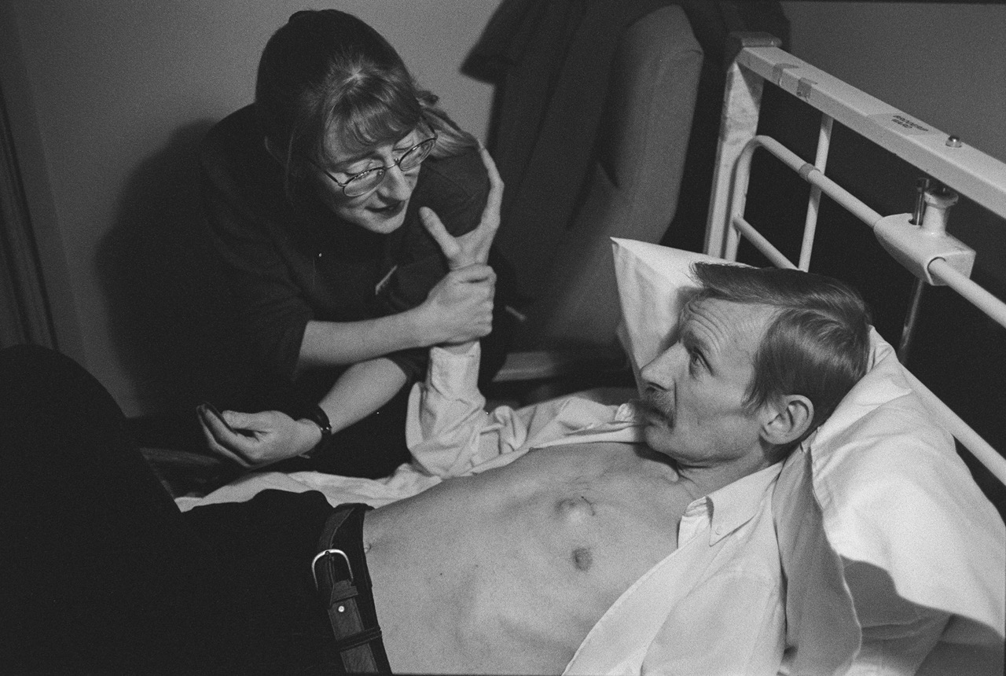

Slide 8
It’s a, it’s a, it’s a…..
1987
1st ARV drug approved
ZIDOVUDINE
Early 90s
More drugs in same
class approved
1995
1st drug in a new class
approved by FDA

Slide 9
Mortality among persons 25–44 years old, USA: 1987–2010
Introduction of COMBINATION ART
40
Unintentional injury
Cancer
Heart disease
Suicide
Homicide
Chronic liver disease
HIV infection
Stroke
Diabetes
30
Deaths per 100,000 population
20
10
0
1987
1988
1989
1990
1991
1992
1993
1994
1995
1996
1997
1998
1999
2000
2001
2002
2003
2004
2005
2006
2007
2008
2009
2010
Adapted from: Centers for Disease Control HIV Mortality (through 2010). Available at: http://www.cdc.gov/hiv/library/slideSets/ [Accessed March 2014]
Notes:
9

Slide 10
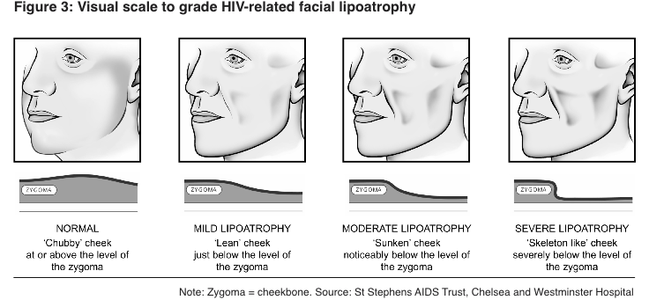
It wasn’t easy….

Slide 11
2
NOW

Slide 12
People in HIV care in England

Slide 13
England: new diagnoses 2,692 new diagnoses = 90% of UK diagnoses

Slide 14
England: new diagnoses by group

Slide 15
Other key figures
5% undiagnosed
99%
on treatment
98%
undetectable
44% diagnosed
LATE

Slide 16
SINCE START OF EPIDEMIC
2021 FIGURES
84.2 million diagnoses
38.4 million with HIV
1.5 million new cases
650k AIDS deaths
40.1 million AIDS-related deaths
28.7 million on ART
75%

Slide 17
U=U
normal life
expectancy

Slide 19
Factors that may drive co-morbidities….

Slide 20
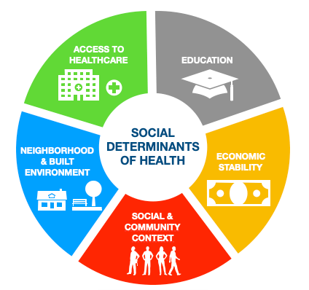

Slide 23
3
FUTURE

Slide 24
VACCINE

Slide 25
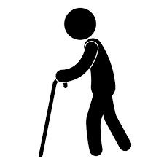
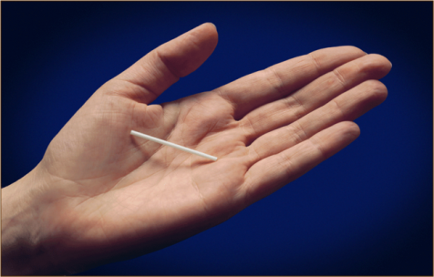
PrEP
VACCINE

Slide 26
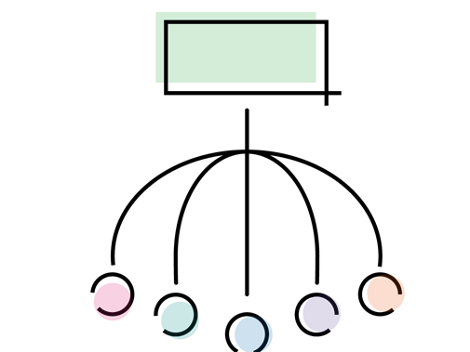
ICS

Slide 27
Training must change
General principles
Of HIV care
Complex
HIV care

Slide 28
4
CLOSING THOUGHTS

Slide 29
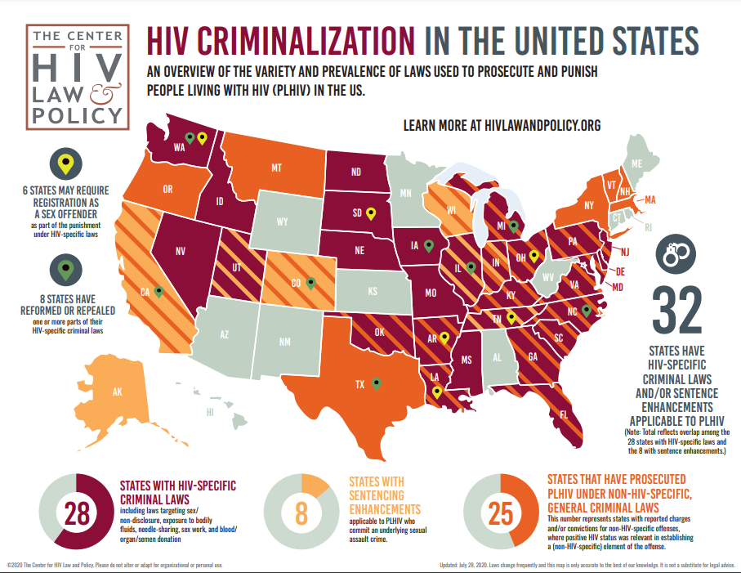
SEX OFFENDER

Slide 30
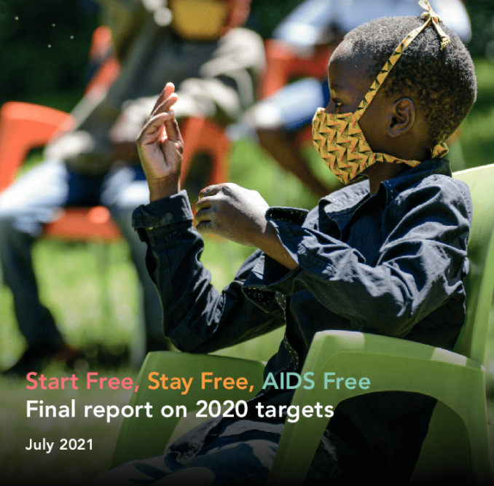
46% of the world’s 1.7 million children living with HIV were not on treatment

Slide 32
Thank you for listening
lwaters@nhs.net
@drlaurajwaters
peoplefirstcharter.org

